Slide 3
Please note :-
‘Musical extracts have been taken from a variety of sources for the sole purpose of illustrating educational points’ This resource is not for resale and is only intended for educational purposes.
Music Teachers must consider the use of this resource in the context of the overall music curriculum plan for their school, including progression, pedagogy, assessment and taking full account of the three interrelated pillars as described in the Ofsted Music Research Review of 12th July 2021.

Slide 4

The main composite task in this scheme of work is the production of a short ‘silent movie’ film, with musical accompaniment
All resources needed are in this PowerPoint document. It is divided into sections as follows:
Poster advertising the main features of the scheme of work
The main knowledge organiser for the scheme and two further ‘careers knowledge organisers’ for use as required. They can be reviewed at any point as suits the lesson, or at a later date.
YouTube playlist link: this contains all the tracks needed for the lesson activities. Each track is indicated in red on the relevant slide. E.g. PL3 indicates track 3 on the playlist.
A guide to lesson content and the careers featured. Lessons follow a rough 4 part structure (connect /activate /demonstrate /consolidate ) as used in many schools.
Link to optional video tas. Ideal as flipped learning as homework before starting.
Lesson 1: Power the Music, sound design, diegetic vs non-diegetic
Lesson 2: Careers in film music and sound
Horror film music techniques
Leitmotifs
Comedy film music techniques
Lesson 6/7/8 Create a silent movie and music to accompany it
Bolt on activities to support cultural capital
Printables for all lessons
Literacy / support for dyslexia
Slides are buff with navy sans serif text and minimum 32pt font. Underlining is avoided and 1.5. spacing is used where possible.
Anticipated prior learning and tier 3 keywords for the lesson are presented after the lesson objective slide and highlighted throughout.
Reproduction
These resources are for use within Liverpool City Region and should not be reproduced without prior permission from the author, who can be contacted at nbarker@mylhs.org
ABOUT THIS SCHEME OF
WORK

Slide 5


Which came first in movies? music or talking?
At The Movies
Diegetic or non-diegetic?
Underscore, sync, Foley, dialogue
Leitmotif
Mickey- mousing
Boom, blimp, dead cat?
What difference can music make to how we perceive the action?
Comedy and horror film techniques
Creative Futures Careers:
Production sound mixer | Re-recording mixer | Music supervisor | Sound designer |Film composer | Dubbing mixer | Music editor | Foley editor | ADR editor | Foley artist | Conductor | Musician |
Notes:
Poster

Slide 6
Knowledge Organiser – At The Movies
Sound design | The overall ‘sound concept’ of the film, as imagined by the sound designer. Includes sound from on-screen action and sounds artificially created to help establish the location, time, or mood or the film. E.g. ‘alien’ and ‘outer space’ sounds on the film Alien
Diegetic | Sound we hear that characters also hear, e.g. dialogue, a radio, footsteps. | Non -diegetic | Sound we hear that characters don’t hear. E.g. underscore, narrator.
Underscore | Instrumental music composed for the film by the film composer. It plays ‘under’ the action and dialogue | Dialogue | Words spoken by actors. It is recorded during filming using microphones and booms by the production sound mixer
Sync songs | A pre-existing song licensed by a music supervisor for use in a film. | Original songs | A song written specially for a film by the film composer or another artist/band.
Foley | A technique where the everyday sounds of the action, such as footsteps, are re-created by Foley artists in a studio after filming, to make them clearer.
Mickey mousing | A film technique where the action onscreen matches the music. E.g. someone falling downstairs might sync with a descending scale followed by a cymbal crash. It echoes Word Painting in classical music.
Horror underscore techniques | Ostinato (repeated patterns), pitch bends (glissando), long durations (held notes), accelerando (gradually getting faster), crescendo (gradually getting louder), dynamics extremes (silence>> suddenly loud, pitch extremes (high & low), note clashes (3 or 4 close together pitches), timbre clichés (high piano, spooky synths, Theremin, whispers, chanting, noises)
Leitmotif | A recurring musical idea within the underscore linked with a character or place. The film composer alters leitmotifs to match the action and mood of a scene by changing the rhythm, pitch or orchestration.
Comedy underscore techniques | Ascending and descending scales, Timbre clichés: bass clarinet, pizzicato strings, slide whistle, low brass, low strings, xylophones, piccolo, muted trumpets, triangle, wobbly notes (trills and tremolos), bouncy rhythms (oompah chords), fast tempo, sliding notes (glissando) pitch extremes (very high and very low)

Slide 7
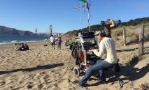
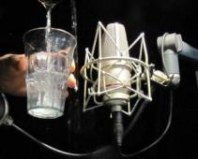
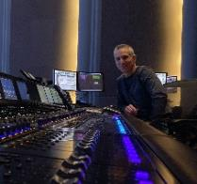
Creative Careers
Production sound mixer / Location sound recordist:
Sound engineers who are responsible for recording all on-set and on-location sound. They ensure that each actor’s performance is captured clearly, without background noise. They check every location for potential sound problems and plan the equipment and set-ups needed. They must keep their ears open during recording for any problems, such as a malfunctioning microphone or passing traffic.
Entry: Audio engineering school / degree, on-set experience, working your way up from Production Assistant, Boom Mic Operator, Utility Sound Tech, to production sound on small indie productions.
Salary:
Production sound mixers are paid per project and
Foley artist / Foley sound mixer
The sound in most films is a combination of field recordings (recorded by the Production Sound Mixer) and Foley effects, such as footsteps, the rustling of clothing as a character moves, doors opening and closing, wind blowing and other ambient noise. These are hard to record cleanly during filming and are instead created during post-production by a team of three: two Foley artists and a Foley sound mixer. Foley studios have different types of surface to walk on and thousands of props that Foley artists use whilst watching the film on screen and emulating the movements of the characters.
Entry
No specific degree or apprenticeship. Instead you need hands-on experience. Try asking a working Foley artist if you can shadow them. Then work as their assistant – paid or unpaid – and learn all you can about the job, keeping a portfolio of sound effects you've created yourself so you can show it in interviews.
At The Movies 1
must provide their own equipment. They begin by hiring it but will eventually buy their own.
Salary
Foley artists are independent, so they set their own rates. Their union guarantees minimum salaries of $2,692.44 per week (2020).
Re-recording mixer / Dubbing mixer: (Gary Summers)
Mixes all the sound tracks (dialogue, ADR, foley, sound effects, atmospheres, sync and underscore), to create the final composite soundtrack.
Gary Summers is an American sound re-recording mixer. He has done the sound re-recording on a number of blockbuster films, including Avatar, Titanic, Terminator 2: Judgment Day, Saving Private Ryan, Transformers: Revenge of the Fallen and Jurassic Park. He has won four Oscars, an Emmy and two BAFTA’s
.
Sound designer: (Ben Burtt Jr)
Sound design enhances the mood and atmosphere of the film to create an immersive experience for the audience. Sound design includes sound effects (SFX) sound design, mixing, Foley sound design, dialogue, and music.
Examples of sound design:
Lightsaber: combination of a film projector's motor hum, TV interference, and waving a mic in front of the speaker to create "swooshing" sabers
Saving Private Ryan — recording period artillery to maximize the authenticity of battle scenes
Benjamin Burtt Jr’s credits include the Star Wars and Indiana Jones film series, E.T (1982), WALL-E (2008) and Star Trek (2009). He created many of the iconic sound effects heard in Star Wars films, including R2D2’s voice, the lightsaber hum, the sound of the blaster guns, Darth Vader’s breathing and the Ewoks’ language, ewokese. He has won four Academy Awards.
ADR editor:
ADR stands for Automated Dialogue Replacement. The ADR editor comes in during post-production (once the film has been shot).
Sometimes dialogue isn’t cleanly recorded during a film’s production. The Production Sound Mixer and Script Supervisor take notes on any unwanted sounds that occur in each scene. The ADR editor uses the notes and re-records the dialogue using the original actors so it is clean and still aligns with the on-screen action.
The new tracks are than sent to the re-recording mixer for inclusion in the final film.
He got his start working on The Empire Strikes Back
and worked for Skywalker Sound (part of George Lucas's Lucas Digital) in California for 20 years.

Slide 8
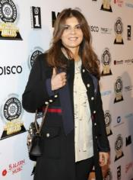

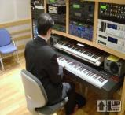
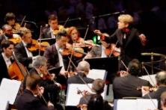
Creative Careers
Music Supervisor: (Nora Felder)
A music supervisor oversees all aspects of music in a film or TV project. This can include working with a composer to pitching songs to managing a budget to negotiating deals.
Entry: Musical ability and knowledge, industry work experience, internship.
Salary: Music supervisors typically earn flat fees for their work, based on the size of project budgets. Most TV music supervisors get paid a few thousand per episode, while the most sought-after music supervisors make upwards of $200,000 for their services for major films.
Film score orchestral session player
The music that film orchestras play varies according to the film, so you might play scary, creepy music one day and romantic music the next.
Film score orchestras don't have set musicians. Instead each player is contracted individually for each film score. This means that the players are all freelancers. The majority of score recordings in Hollywood are done by musicians from the Hollywood Studio Symphony collective. These top musicians go from session to session, performing at the various film scoring stages.
Film score musicians don’t often get to see and practice the music beforehand so sight-reading skills are important. On-the-spot changes in the score are also common. Timing is crucial; to ensure that the score matches the film exactly it is usually recorded with the silent film running on a screen. The musicians are given headphones and play to a click track.
Entry: Instrumental tuition and performance exams on your instrument then study at a specialist Music conservatoire, gaining experience in as many orchestras as possible.
Starting out: Famous Film composer John Williams started his career as a session recording orchestral musician.
At The Movies 2
Two-time Emmy and Grammy nominated Music Supervisor Nora Felder began her career booking artist showcases and events in NYC. She has supervised for TV Series including “Californication”, “Stranger Things”, “Ray Donovan” and “Swipe Right”.
Film composer (Kathryn Bostic)
Music composers do more than write symphonies like Mozart and Beethoven! Jobs are available conducting orchestras, composing soundtracks for films, writing songs for commercials, producing records, and teaching.
Kathryn Bostic is the first female African-American composer to be a member of the Academy of Motion Picture Arts & Sciences. She composed scores for Middle of Nowhere, Dear White People, Toni Morrison: The Pieces I Am and Clemency.
Salary:
For a studio feature, composers may be paid $60,000 to $250,000 for a low budget film, $250,000 to $350,000 for a medium budget film and $400,000 to $2 million for a high budget film. Ultimately, it depends on the budget for the music
Video Game Composer (Koji Kondo)
Composers use their creativity, imagination and technical ability to craft memorable and well- matched musical scores to complement the worlds evoked in video games.
Video game music was originally limited to the basic sounds that could be made by the computers of the time. It sounds really electronic and clunky these days. As the universes and plotlines of video games become richer and more vivid and the capabilities of music technology exploded, game soundtracks have become more like film scores and the great orchestral works of the past.
Conductor (Marin Alsop)
A Conductor leads an orchestra, opera, or other musical ensemble through visible gestures, setting the tempo and shaping the group’s interpretations and sound. They can work for large professional orchestras and choirs, in cathedrals and churches, in musical theatre, on film productions. Permanent jobs for conductors are limited, and most work on a freelance basis.
Entry:
Degree and postgraduate
qualification in music composition and a portfolio of work.
Koji Kondo who works for Nintendo, was the creator of the music for Super Mario Bros.
Marin Alsop is an American conductor who works with lots of orchestras all over the World.

Slide 9
Click here for At The Movies YouTube playlist
Flipped learning | How film scores play with our brains | Intro: Star Wars: The Seventh Symphony Featurette
Lesson 1: The Power of Music in film | Mini documentary The Power of Music in Film Diegetic and non-diegetic sound Example: Wood Elves Example: Saturday Night Fever street walking scene Example: Lothlorien Example: Saturday Night Fever disco scene | Example: Buddy Holly Roller Rink scene Example: Blazing Saddles jazz band scene Star IV final scene - with music Star Wars IV final scene - without music Example: Pulp Fiction Chuck Berry Forrest Gump long run scene
Lesson 2: Film sound Careers | Film composer / session musician . Recording engineers - The Hobbit: creating the music with Howard Shore Music Supervisor: Stranger Things - Nora Felder Production Sound Mixer: Rode Microphones on set | ADR; How to do ADR Foley: The Magic of Making Sound Re-recording Mixer (Sony)
Lesson 3: Horror underscore techniques | Mickey Mousing: Silly Symphonies Skeleton Dance Horror Tricks of the Trade: Jaws theme Horror Tricks of the Trade: Halloween 1978 trailer Horror Tricks of the Trade: Alien 1979 trailer | Horror Tricks of the Trade: Terror from Beyond Space Horror Tricks of the Trade: The Thing Horror Tricks of the Trade: Nightmare on Elm Street
Lesson 4: (optional) Leitmotif | Lord of the Rings: How Music Elevates a Story – themes / leitmotifs How John Williams Builds a Character – Yoda Wonder Woman: how Wonder Woman’s theme went from bombastic to smart
Lesson 5: (Optional ) Comedy underscore techniques | Space Hopper Race Mussorgsky Night on a Bare Mountain Tchaikovsky 1812 overture from 11:40 Offenbach – Can Can Home Alone 2 OST 6 The Thieves Home Alone OST5 Man of the House Home Alone OST7 Scammed Home Alone OST 10 Plane | Home Alone OST16 Attack on the House Home Alone 2 OST14 Race Home Alone 2 OST20 Running Home Alone 2 OST22 Kevin’s trap Home Alone 2 OST23 Down the Rope How to write a comedy soundtrack Funniest Dogs and Cats
Lesson 6/7/8 | Horror example - Hereditary Comedy example – the Gonk
Extension | How to score the same movies scene as four different genres

Slide 10
Lesson overview *optional
 | Keywords | Learning | Careers
1 | Diegetic Non-diegetic Sound design Underscore Foley Sync Dialogue | The Power of music Why do films have music? Were silent movies really silent? What are the main two types of music and sound in a film What are the four sub-types of music and sound in a film | Film composer Film score session orchestra musician Production sound mixer | Foley artist Music supervisor
2 | See careers column | Careers in film music and sound Introduction to each career in turn, with video Pupils rehearse a short script and then record it in groups ‘on location’ using mobile devices They discuss the challenges of recording in various acoustic environments / levels of background noise and note which background sounds were helpful and which were not. | Film composer Film score session orchestra musician Sound engineer Sound designer Production sound mixer | Foley artist/editor Music supervisor ADR editor Re-recording mixer
3 | Under-score Ostinato Accelerando Crescendo Pitch Timbre | Horror film underscore music Introduction to horror film techniques Listening : recognising horror techniques Demonstrate horror techniques on keyboards | Film composer Film score session orchestra musician | Sound designer Foley artist/editor
4* | Motif Leitmotif Develop | Leitmotif Try out two mystery character themes on keyboards and guess the character Introduction to leitmotifs - video Co-composing leitmotifs for two cartoon characters using scales Independent/ paired leitmotif creation Wonderwoman’s changing leitmotif – video Independent development of the Fellowship of the ring leitmotif | Film composer Film score session orchestra musician
5* | Underscore Trills and tremolandos Pizzicato Glissando | Comedy film underscore music Listen to three different underscores (existing classical music) accompanying a space hopper race and comment on the effect Introduction to comedy film techniques Listening : recognising comedy techniques Demonstrate: add comedy music to a comic video montag | Film composer Film score session orchestra musician
6-8 | n/a | Silent Movie Project Create a storyboard and silent movie intertitles (template available) Film the project on iPhones/ Android phones etc Edit the project in iMovie or similar, using a black and white filter Create a musical underscore suitable for the genre of the film, record it over the film sing the voiceover function | Film composer Film score session orchestra musician Foley artist/editor

Slide 11
Optional flipped learning task – to watch as homework before starting the scheme of work
Watch this video PL1
And this one PL2

Slide 12

Mindmap your ideas
Film sound tracks
What we know already

Slide 13
How can music and sound enhance a film’s dramatic impact?
Know how sound and music on film began Appreciate the impact and purpose of music and sound in film Know 2 main and 4 sub-types of sound / music and the impact of each.

Slide 14
How can music and sound enhance a film’s dramatic impact?
Prior learning | Keywords
Composer Musician Silent movie | Soundtrack Sound design Diegetic and non-diegetic Dialogue, underscore Sync, Foley

Slide 15
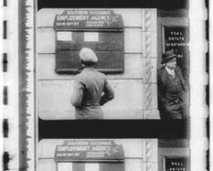
Activate: What is a film soundtrack?
Did you know that all the sound for the film is on there too, as one long track, running alongside the pictures >>sound track
You probably recognise that this is a piece of movie “filmstrip”
Each “frame” is shown on screen for 1/24th of a second to give the illusion of movement.

Slide 16
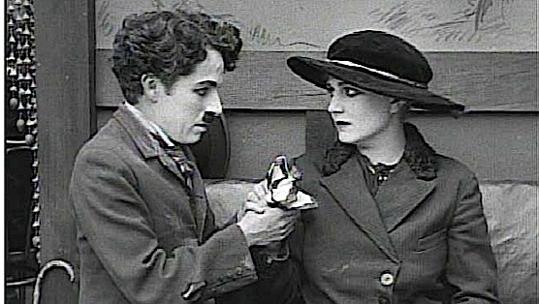
Did early movies have soundtracks?
No - soundtrack technology didn’t take off at first, so there was no sound on the film.
This is why we say “silent movie”
Notes:
See Phonofilm - invented in the early 1920’s

Slide 17
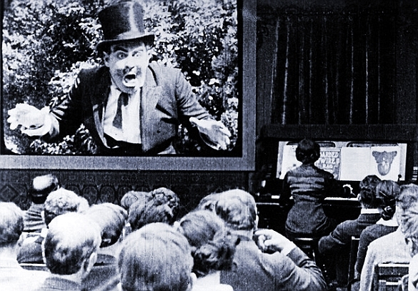
Were silent movies really silent though?
No - live music was played on piano or organ to drown out the projector’s noise and stop the theatre being silent
Pianists would improvise or play existing classical music that they already knew
Notes:
The size of the exhibition site determined the musical accompaniment: Small town: live pianist. City: theatre organist. Major city: orchestra.
Some theatre organs had special effects, including train whistles, car horns, birdsong, pistol shots, ringing phones, surf, horses' hooves, smashing pottery, thunder and rain.
Once full features became common, music was compiled from existing music by the live musician, the orchestra conductor or the movie studio.

Slide 18
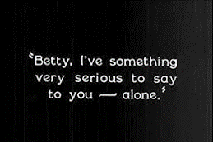
Were silent movies really silent?
Did silent movies really have no words though?
No - early short films had a live narrator in the theatre.
As films got longer, intertitles like this one showed some written dialogue.
Notes:
The narrator would explain the film to the audience.
The title writer became a key film career

Slide 19
So, silent movies weren’t really silent?
No!

Slide 20
Why was music so important even in silent films?
Film makers saw how music also contributed atmosphere, and helped the audience to feel the emotions.

Slide 21
Activate: The power of music in film
Watch The Power of Music in Film PL3
As the clip shows, the music / sound heard in a film has a huge effect on how we interpret what we see with our eyes
Notes:
Further discussion: how was music used in the 2nd clip to achieve the following impacts?
establish atmosphere, time and place
describe character
add to dramatic impact
tell us things we don’t see with our eyes

Slide 22
A film’s overall sound (everything on the soundtrack) is called its sound design
The sound design has two elements
Diegetic sound
We hear it and the characters hear it
Non-diegetic sound Only we hear it
Character sounds
Environment sounds
Dialogue
Underscore (film score)
Narrator
Watch this video PL4
Notes:
Character sounds: footsteps, breathing
Environment sounds: waves, cars, gunshots, crowds

Slide 23
Demonstrate: Diegetic or non-diegetic?
Characters can hear it
We can hear it but characters can’t
The film score
A character’s own footsteps
A narrator
A DJ playing a track in a nightclub scene
Diegetic
Non-Diegetic
Non-Diegetic
Diegetic
Non-Diegetic
Diegetic

Slide 24
Watch these film extracts – is the music diegetic or non-diegetic?
Wood Elves, LOTR PL5
Stayin Alive PL6
Lothlorien PL7
You should be dancin’ PL8
Buddy Holly PL9
Blazing Saddles PL10
Diegetic
Internal diegetic
Non-diegetic
Diegetic
Diegetic
Diegetic, but we think
it’s non-diegetic

Slide 25
What are the different types of sound/music? (click links below)
1. Underscore | 2. Sync
3. Foley | 4. Dialogue
Next section

Slide 26
Activate: What impact does an underscore have?
back
We will watch a film excerpt twice
  With its underscore by John Williams, a film composer PL11
  Without the underscore PL12
What is different about how you perceive the scene?

Slide 27
1. Underscore
Written for the film, by a film composer
Instrumental music which plays beneath other sounds without drowning out the dialogue
Sets or enhances the mood for a scene
Most songs in films are diegetic. Songs that are non-diegetic are used for action scenes where there is no dialogue.
Underscores are what famous film composers like John Williams, Hans Zimmer and Ennio Morricone write

Slide 28
Activate: 2. Sync
Songs are often featured in films
  Original songs: songs written specially for a film.
  Sync’d songs: existing songs which are used in a film
When a filmmaker wants to use a song in a film, they have to ask the songwriter / performer first
If they agree, they will sign a ‘sync’ deal and the artist will earn money

Slide 29
Why is sync good for the music industry?
Sync allows audiences to discover new music, helps new artists become well known and helps older artists find new fans
  e.g. Chuck Berry “Never Can Tell” PL13
Quentin Tarantino (Pulp Fiction, Reservoir Dogs) is famous for not using film composers at all. All the music in his films is sync’d. He works with music supervisor Mary Ramos to find forgotten vintage music from the 60’s and 70’s.
back

Slide 30
3. Foley
back
A Foley artist recreates the natural everyday sounds for a film as these can be hard to record on set.
The most common sound is footsteps
The sounds are recreated using special techniques in a Foley studio.
This provides a much clearer sound than would have been recorded on location.
Notes:
Dead Cat = furry thing

Slide 31
4. Dialogue
The idea is to record clear dialogue without the audience seeing any microphones!
The easiest way to do this is with the camera’s own microphone, but sometimes that can’t be done
Notes:
Boom – long stick
Blimp – protective cover for microphone
Shotgun mic- less background noise, but booms can cause problems
Lavalier mic - less natural sound, omnidirectional pickup, good safety net/ backup mic. Good for wide shots

Slide 32
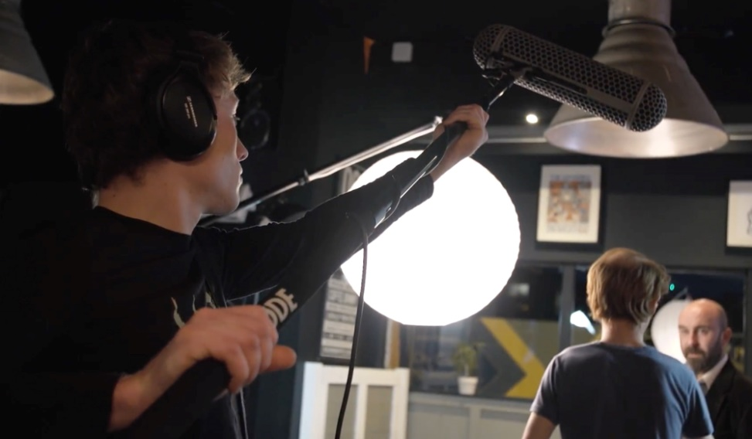
4. How is dialogue recorded?
For closer shots:
Short shotgun mic inside a blimp (protective cover)
Boom (long stick) holds mic out of shot
Notes:
Boom – long stick
Blimp – protective cover for microphone
Shotgun mic- less background noise, but booms can cause problems
Lavalier mic - less natural sound, omnidirectional pickup, good safety net/ backup mic. Good for wide shots

Slide 33
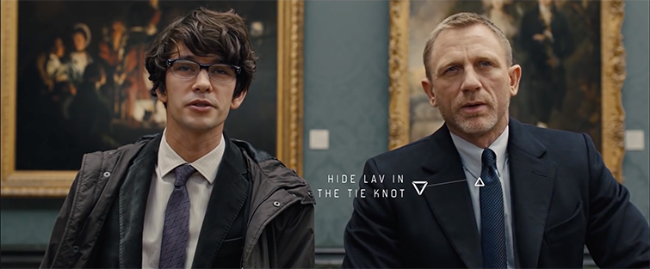
4. How is dialogue recorded?
For wide shots:
A boom would be in shot, so a lavalier mic can be hidden under the chin or in clothing
Notes:
Boom – long stick
Blimp – protective cover for microphone
Shotgun mic- less background noise, but booms can cause problems
Lavalier mic - less natural sound, omnidirectional pickup, good safety net/ backup mic. Good for wide shots

Slide 34
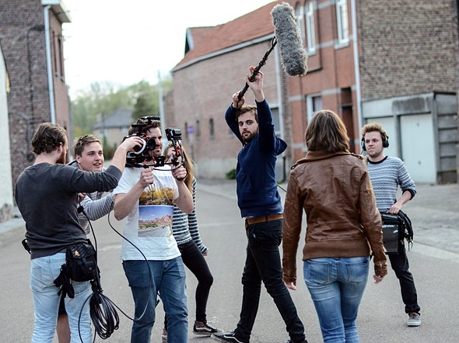
4. How is dialogue recorded?
back
For outdoor shots:
Long shotgun mic, a blimp, a boom and a dead cat!
Some outdoor scenes might need have dialogue re-recorded in a studio. Why do you think this is?
Answer: Crowds, diegetic sounds from the action or scenery, unexpected noises or equipment faults can obscure the dialogue.
Notes:
Dead cat – furry wind cover

Slide 35
Consolidate: Watch and listen: Forrest Gump PL14
Is Forrest Gump’s narration diegetic, non diegetic or internal diegetic?
How do we know he has got to the ocean before we see it?
What other types of sound are there and how would they have been created?
It appears non-diegetic but at 1:12 we see that he is talking to someone so it is diegetic
Environment sound – seagulls
There is
Non diegetic sound - film underscore, by Film Composer Alan Silvestri
Non diegetic sound – sync tracks by Music Supervisor Joel Sill
Diegetic character sounds – footsteps, foley studio
Diegetic environment sounds - TV, waves, traffic, crockery, foley studio
Diegetic sound – dialogue – recorded on set, ADR’d afterwards
Notes:
STOP before 4m are there is inappropriate language “shit happens”

Slide 36
Where can music take you?
Production sound mixer / Location sound recordist:
Sound engineers who are responsible for recording all on-set and on-location sound. They ensure that each actor’s performance is captured clearly, without background noise. They check every location for potential sound problems and plan the equipment and set-ups needed. They must keep their ears open during recording for any problems, such as a malfunctioning microphone or passing traffic.
Entry: Audio engineering school / degree, on-set experience, working your way up from Production Assistant, Boom Mic Operator, Utility Sound Tech, to production sound on small indie productions.
Salary:
Production sound mixers are paid per project and
Foley artist / Foley sound mixer
The sound in most films is a combination of field recordings (recorded by the Production Sound Mixer) and Foley effects, such as footsteps, the rustling of clothing as a character moves, doors opening and closing, wind blowing and other ambient noise. These are hard to record cleanly during filming and are instead created during post-production by a team of three: two Foley artists and a Foley sound mixer. Foley studios have different types of surface to walk on and thousands of props that Foley artists use whilst watching the film on screen and emulating the movements of the characters.
Entry
No specific degree or apprenticeship. Instead you need hands-on experience. Try asking a working Foley artist if you can shadow them. Then work as their assistant – paid or unpaid – and learn all you can about the job, keeping a portfolio of sound effects you've created yourself so you can show it in interviews.
At The Movies 1
must provide their own equipment. They begin by hiring it but will eventually buy their own.
Salary
Foley artists are independent, so they set their own rates. Their union guarantees minimum salaries of $2,692.44 per week (2020).
Re-recording mixer / Dubbing mixer: (Gary Summers)
Mixes all the sound tracks (dialogue, ADR, foley, sound effects, atmospheres, sync and underscore), to create the final composite soundtrack.
Gary Summers is an American sound re-recording mixer. He has done the sound re-recording on a number of blockbuster films, including Avatar, Titanic, Terminator 2: Judgment Day, Saving Private Ryan, Transformers: Revenge of the Fallen and Jurassic Park. He has won four Oscars, an Emmy and two BAFTA’s
.
Sound designer: (Ben Burtt Jr)
Sound design enhances the mood and atmosphere of the film to create an immersive experience for the audience. Sound design includes sound effects (SFX) sound design, mixing, Foley sound design, dialogue, and music.
Examples of sound design:
Lightsaber: combination of a film projector's motor hum, TV interference, and waving a mic in front of the speaker to create "swooshing" sabers
Saving Private Ryan — recording period artillery to maximize the authenticity of battle scenes
Benjamin Burtt Jr’s credits include the Star Wars and Indiana Jones film series, E.T (1982), WALL-E (2008) and Star Trek (2009). He created many of the iconic sound effects heard in Star Wars films, including R2D2’s voice, the lightsaber hum, the sound of the blaster guns, Darth Vader’s breathing and the Ewoks’ language, ewokese. He has won four Academy Awards.
ADR editor:
ADR stands for Automated Dialogue Replacement. The ADR editor comes in during post-production (once the film has been shot).
Sometimes dialogue isn’t cleanly recorded during a film’s production. The Production Sound Mixer and Script Supervisor take notes on any unwanted sounds that occur in each scene. The ADR editor uses the notes and re-records the dialogue using the original actors so it is clean and still aligns with the on-screen action.
The new tracks are than sent to the re-recording mixer for inclusion in the final film.
He got his start working on The Empire Strikes Back
and worked for Skywalker Sound (part of George Lucas's Lucas Digital) in California for 20 years.

Slide 37
Where can music take you?
Music Supervisor: (Nora Felder)
A music supervisor oversees all aspects of music in a film or TV project. This can include working with a composer to pitching songs to managing a budget to negotiating deals.
Entry: Musical ability and knowledge, industry work experience, internship.
Salary: Music supervisors typically earn flat fees for their work, based on the size of project budgets. Most TV music supervisors get paid a few thousand per episode, while the most sought-after music supervisors make upwards of $200,000 for their services for major films.
Film score orchestral session player
The music that film orchestras play varies according to the film, so you might play scary, creepy music one day and romantic music the next.
Film score orchestras don't have set musicians. Instead each player is contracted individually for each film score. This means that the players are all freelancers. The majority of score recordings in Hollywood are done by musicians from the Hollywood Studio Symphony collective. These top musicians go from session to session, performing at the various film scoring stages.
Film score musicians don’t often get to see and practice the music beforehand so sight-reading skills are important. On-the-spot changes in the score are also common. Timing is crucial; to ensure that the score matches the film exactly it is usually recorded with the silent film running on a screen. The musicians are given headphones and play to a click track.
Entry: Instrumental tuition and performance exams on your instrument then study at a specialist Music conservatoire, gaining experience in as many orchestras as possible.
Starting out: Famous Film composer John Williams started his career as a session recording orchestral musician.
At The Movies 2
Two-time Emmy and Grammy nominated Music Supervisor Nora Felder began her career booking artist showcases and events in NYC. She has supervised for TV Series including “Californication”, “Stranger Things”, “Ray Donovan” and “Swipe Right”.
Film composer (Kathryn Bostic)
Music composers do more than write symphonies like Mozart and Beethoven! Jobs are available conducting orchestras, composing soundtracks for films, writing songs for commercials, producing records, and teaching.
Kathryn Bostic is the first female African-American composer to be a member of the Academy of Motion Picture Arts & Sciences. She composed scores for Middle of Nowhere, Dear White People, Toni Morrison: The Pieces I Am and Clemency.
Salary:
For a studio feature, composers may be paid $60,000 to $250,000 for a low budget film, $250,000 to $350,000 for a medium budget film and $400,000 to $2 million for a high budget film. Ultimately, it depends on the budget for the music
Video Game Composer (Koji Kondo)
Composers use their creativity, imagination and technical ability to craft memorable and well- matched musical scores to complement the worlds evoked in video games.
Video game music was originally limited to the basic sounds that could be made by the computers of the time. It sounds really electronic and clunky these days. As the universes and plotlines of video games become richer and more vivid and the capabilities of music technology exploded, game soundtracks have become more like film scores and the great orchestral works of the past.
Conductor (Marin Alsop)
A Conductor leads an orchestra, opera, or other musical ensemble through visible gestures, setting the tempo and shaping the group’s interpretations and sound. They can work for large professional orchestras and choirs, in cathedrals and churches, in musical theatre, on film productions. Permanent jobs for conductors are limited, and most work on a freelance basis.
Entry:
Degree and postgraduate
qualification in music composition and a portfolio of work.
Koji Kondo who works for Nintendo, was the creator of the music for Super Mario Bros.
Marin Alsop is an American conductor who works with lots of orchestras all over the World.

Slide 38
What different careers are involved in film music and sound?
Know key careers in film music and sound
Try your hand at being a production sound mixer
Analyse the effect of helpful and unhelpful background sound on dramatic impact

Slide 39
What different jobs are involved in creating film music and sound?
Keywords
Film composer Session musician Sound engineer Sound designer Music supervisor Production sound mixer ADR editor Foley artist/editor Re-recording mixer

Slide 40
Activate: careers in film music/sound
The overall sound of a film is called the sound design
But it is not just the work of the film composer - lots of amazing careers work towards the sound design…
Film composer
Session musician
Sound engineer
Sound designer
Music supervisor
Production sound mixer
ADR editor
Foley artist/editor
Re-recording mixer

Slide 41
Activate: careers in film music/sound
You will already have heard of film composers and may even know some famous ones
  Watch the clip PL15 to see how closely a film composer works with the writer, director and producer of a film as well as the musicians who play their compositions and the sound recording engineers who record the music
Film Composer | Writes the musical score and helps with recordings. May sometimes conduct a studio orchestra.
Session Musicians | Professionals who play the music on film scores. They don’t rehearse - they just turn up and play
Notes:
No need to watch all of it!

Slide 42
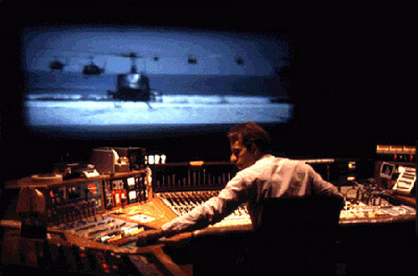
Sound Designer (PL16)
Walter Murch, Apocalypse Now
Conceptualises the ‘sound’ of the film to give the sense of location, period or mood that the director wants
Helps to create an immersive experience for the audience.
Ben Burtt Jr: Lightsaber: combined film projector's motor, TV interference, and waving a mic in front of the speaker to create "swooshing" sound
Walter Murch, shown here is the “Godfather” of Sound design for his work on Apocalypse Now

Slide 43
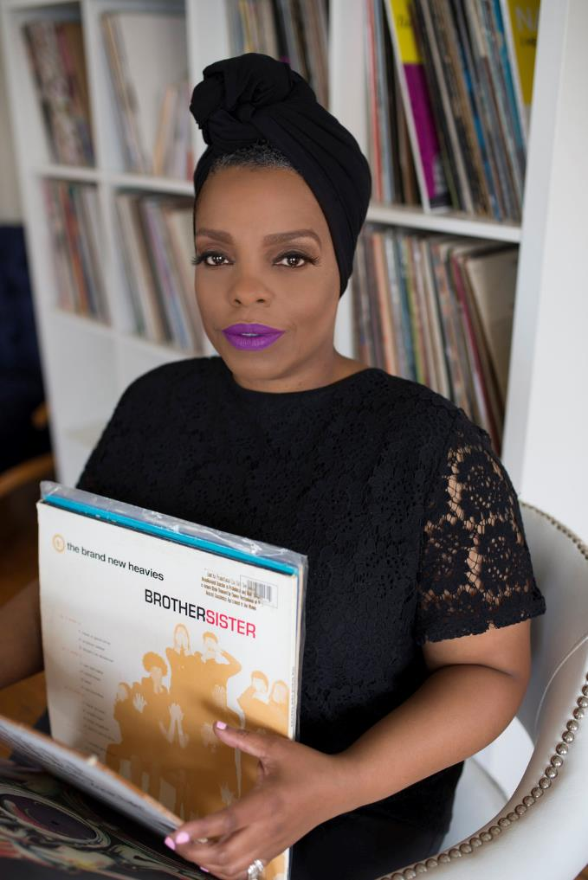
Music Supervisor PL16
Oversees all aspects of music in a film or TV project.
This can include working with a songwriter, pitching songs to the directors and actors, managing a budget, negotiating ‘sync’ deals and dealing with sync licensing and clearance
Morgan Rhodes, Music Supervisor, Selma
Notes:
Watch 2:30 – 7:30 if time

Slide 44
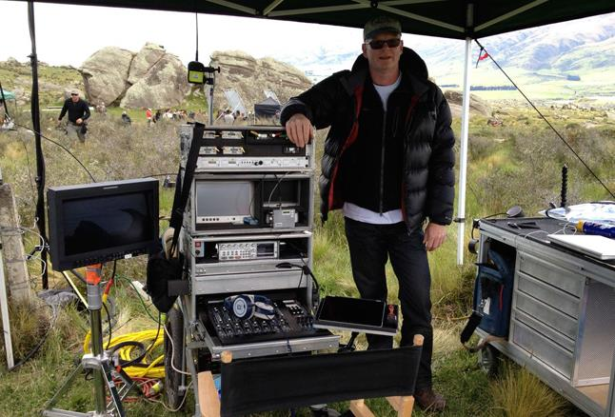
Production sound mixer PL17
Responsible for planning and leading the recording of all sound on set/location:
  Ensure each actor’s performance is captured clearly, without background noise.
  Check every location for potential sound problems and plan equipment and set-ups needed.
  Keep their ears open during recording for any problems, such as a malfunctioning microphone or passing traffic.

Slide 45
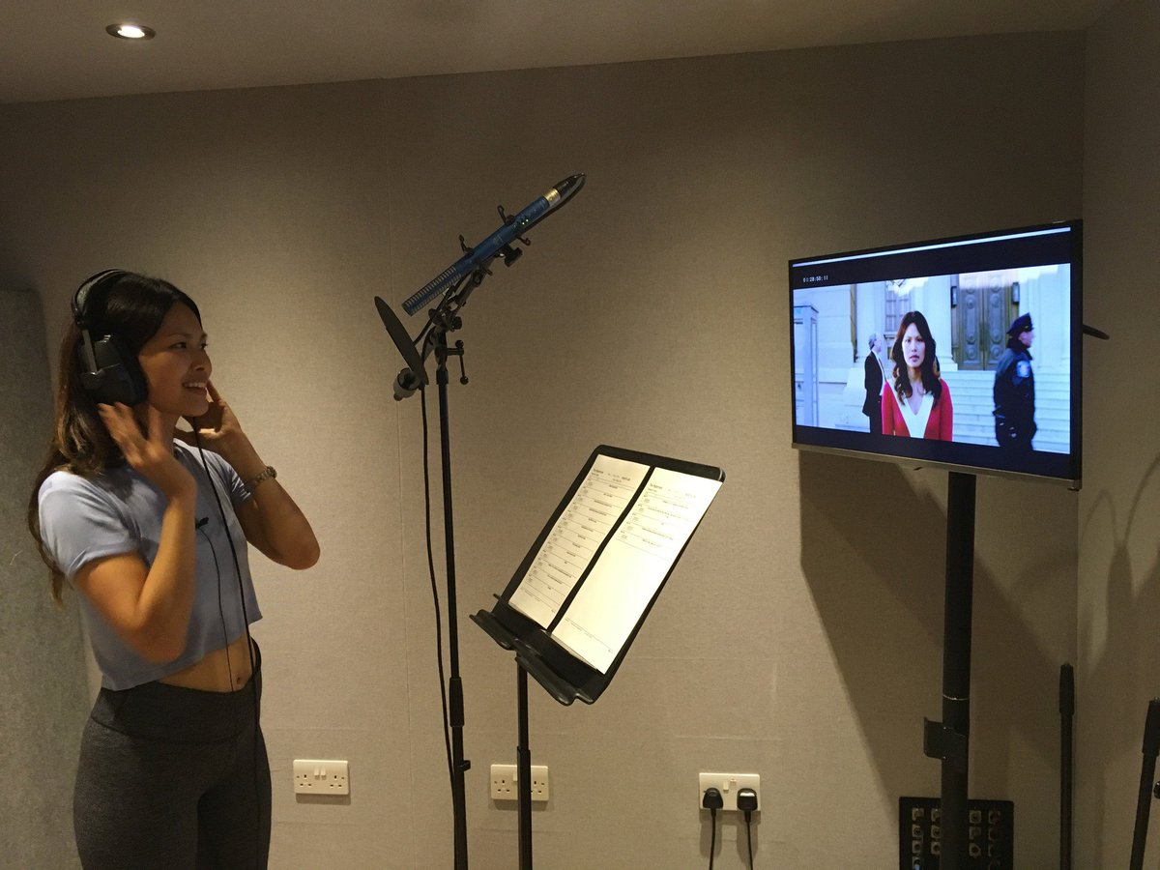
ADR Editor PL18
ADR editor comes in during post-production (after filming)
  Sometimes dialogue isn’t cleanly recorded. The Production Sound Mixer notes down any problems
  The ADR editor uses the notes and re-records the dialogue using the original actors so it is clean and still aligns with the on-screen action.
  The new tracks are sent to the re-recording mixer for inclusion in the final film.

Slide 46
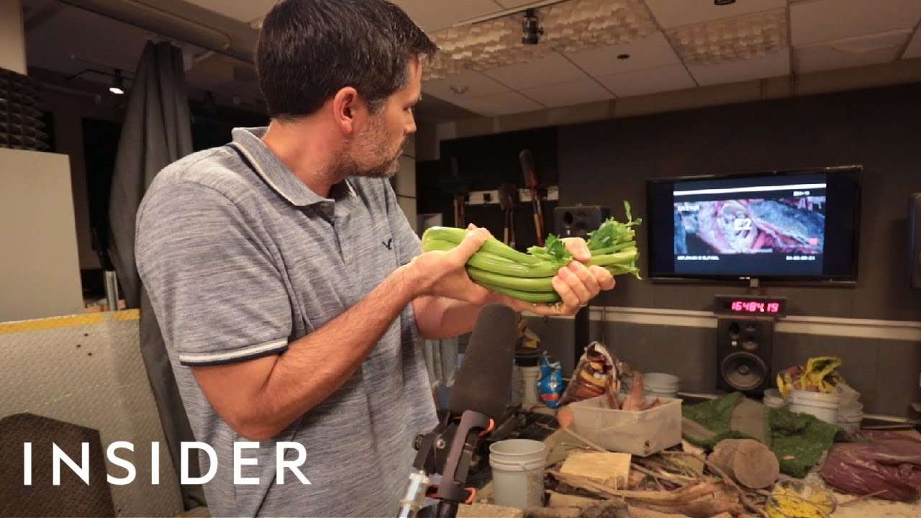
Foley Artist/Editor PL19
Foley Artist,
A Quiet Place
The sound in most films is a combination of recordings made by the Production Sound Mixer and Foley artists.
  Sounds which are hard to record cleanly during filming are re-created during post-production by a team of three: two Foley artists and a Foley sound mixer. Foley studios have different types of surface to walk on and thousands of props that Foley artists use whilst watching the film on screen and emulating the movements of the characters.

Slide 47
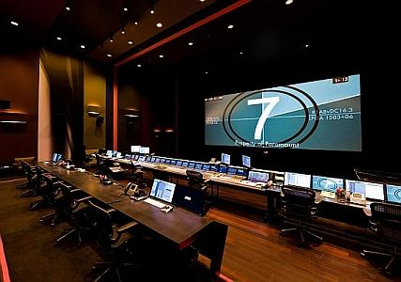
Re-recording Mixer PL20
Dubbing Stage, where the re-recording mixers do their work
Mixes all the sound tracks (dialogue, ADR, foley, sound effects, atmospheres, sync and underscore), to create the final composite soundtrack.

Slide 48
Film music roles – match the career with the job description
ADR Editor | Writes the musical ‘underscore’ and helps with recordings. May sometimes conduct a studio orchestra.
Musicians | Professionals who play the music on film scores
Film Composer | Conceptualise the sound ’landscape’ of the film to give the sense of location, period or mood that the director wants
Sound Designer | Responsible for planning and leading the recording of all dialogue and sound on set/location.
Foley Artist/ Editor | Responsible for music imported (i.e. songs that already exist). They negotiate ‘sync’ deals and re-recording
Production sound mixer | Re-records dialogue that wasn’t cleanly recorded during production, using the original actors
Re-recording Mixer | Recreates natural sounds created by action on screen e.g. footsteps, artificially after filming
Music Supervisor | Mixes all the sound tracks (dialogue, ADR, Foley, sound effects, atmospheres, sync and score), to create the final soundtrack

Slide 49
Location sound mixer task
Split into groups. Each group should take a script and go to a different part of the school as directed by your teacher.
You are now location sound mixers on a film set!
Using the script (see next slide) perform and record some film dialogue with the voice recorder function on a phone or tablet
Meet back here in 10mins with your finished recording.

Slide 50
Production sound mixer task: recording dialogue
Scene from: The Social Network, 2010
MARK I apologize, okay? Sit down. I'm sorry and I mean it.
ERICA I have to study.
MARK You don't have to study. Let's just talk.
ERICA I can't.
MARK Why?
ERICA Because it's exhausting. Going out with you is like dating a StairMaster.
MARK All I meant is that you go to B.U. and so you're not likely to--I wasn't making a comment on your parents—I was saying you go to B.U.
ERICA I have to go study.
MARK You don't have to study.
ERICA How do you know I don't have to study?!
MARK Because you go to B.U. ……Do you want to get some food?
ERICA I'm sorry you're not sufficiently impressed with my education…..I think we should just be friends.
MARK I don't need friends.
ERICA I was being polite, I had no intention of being friends with you.
MARK You're really leaving. [ ERICA takes MARK's hand and looks at him tenderly.]
ERICA Listen, You are probably going to be a very successful computer guy. But you're going to go through life thinking that girls don't like you because you're a nerd. And I want you to know, from the bottom of my heart, that that won't be true. It'll be because you're an asshole.
* Mark is Mark Zuckerberg, CEO of Facebook
** Erica is his girlfriend
*** BU is Boston University

Slide 51
Consolidate: Listening back and discussion
Listen back to some/all the recordings and discuss:
  How many takes did you do?
    Did you make any mistakes/forget to press record?
  How clear is the recording?
    How could you improve it next time?
  What sounds can you hear in the background?
    Which sounds helped to set the scene/give atmosphere
    Which sounds weren’t helpful?
    Can other people tell where in the school the recording was made?
  If you were filming this scene for real, what plans or adjustments/ equipment might you use to
      Create more atmosphere
      Reduce unwanted sounds
  This scene actually takes place in a crowded bar, not in a school or university.
    What background sounds might you want to have in the sound design in order to create the correct atmosphere?

Slide 52
Quiz
Dialogue between actors is recorded on set by a ________
A kettle boiling is a _______ sound
Footsteps would be re-created after filming by a _________
Britney Spears’ 2003 song “Toxic” features in Promising Young Woman (2021). It would have been licensed for use in the film by a ________
All these different sounds would be mixed onto a final film sound track by which job role?
Foley Artist
Production Sound Mixer
Music Supervisor
Re-recording Mixer
Diegetic

Slide 53
Film music roles – match the career with the job description
ADR Editor | Writes the musical ‘underscore’ and helps with recordings. May sometimes conduct a studio orchestra.
Musicians | Professionals who play the music on film scores
Film Composer | Conceptualise the sound ’landscape’ of the film to give the sense of location, period or mood that the director wants
Sound Designer | Responsible for planning and leading the recording of all dialogue and sound on set/location.
Foley Artist/ Editor | Responsible for music imported (i.e. songs that already exist). They negotiate ‘sync’ deals and re-recording
Production sound mixer | Re-records dialogue that wasn’t cleanly recorded during production, using the original actors
Re-recording Mixer | Recreates natural sounds created by action on screen e.g. footsteps, artificially after filming
Music Supervisor | Mixes all the sound tracks (dialogue, ADR, Foley, sound effects, atmospheres, sync and score), to create the final soundtrack

Slide 54
Answers
Film composer | Writes the musical ‘underscore’ and helps with recordings. May sometimes conduct a studio orchestra.
Session musicians | Professionals who play the music on film scores
Sound Designer | Conceptualise the sound ’landscape’ of the film to give the sense of location, period or mood that the director wants
Production sound mixer | Responsible for planning and leading the recording of all dialogue and sound on set/location.
Music Supervisor | Responsible for all music on a project. They negotiate ‘sync’ deals.
ADR Editor | Re-records dialogue that wasn’t cleanly recorded during production, using the original actors
Foley artist/ editor | Recreates natural sounds created by action on screen e.g. footsteps, artificially after filming
Re-recording mixer | Mixes all the sound tracks (dialogue, ADR, Foley, sound effects, atmospheres, sync and score), to create the final soundtrack

Slide 55
Working on film sound
Know key careers in film music and sound
Try your hand at being an ADR editor, a sound designer and a film composer
Analyse the effect of helpful and unhelpful background sound on dramatic impact

Slide 56
Y:\MUSIC public\Year 9\At The Movies 2022\9I\9I Use this one

Slide 57
What musical tricks of the trade are used in the horror film genre?
Recognise and name different horror film music techniques Recreate techniques on keyboards Create a still image storyboard for a horror film Combine musical techniques to bring your storyboard to life without words

Slide 58
Keywords
Underscore – music specially composed for a film to play ‘under’ the action Genre - a style or category of music Ostinato – a repeated pattern Accelerando – an increase in tempo Crescendo – an increase in dynamic Pitch – the highness or lowness of a note Timbre – the type of sound e.g. metallic
Notes:
Prior learning: blues scale, pentatonic scale

Slide 59
What is an underscore for?
Film underscores tell the audience what to feel and what to expect, not just what is on screen.
Horror film underscores help to create tension, fear, anticipation, shock and …horror!
There are several techniques for this…

Slide 60
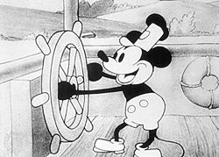
Tools of the trade: mickey mousing
Walt Disney cartoons closely matched movements on screen to the cartoon’s music. This is called mickey mousing.
It was often used in cartoons (sneaking about), comedies (falling over), horror films (stabbing) and thrillers (fighting) but is out of fashion now
PL22

Slide 61
Horror underscore techniques:
Mickey mousing
Ostinato (repeated patterns)
Timbre clichés (high piano, screechy strings, spooky synths, Theremin, whispers, chanting, noises)
Long durations (held notes)
Accelerando (gradually getting faster)
Dynamics extremes (silence>> suddenly loud)
Pitch extremes (high & low)
Note clashes (3 or 4 close together pitches)
Crescendo (gradually getting louder)
Glissando (pitch bends)

Slide 62
Horror film music techniques PL22-27
Techniques | Jaws | Halloween | Alien | Terror | The Thing | Nightmare on Elm St
Ostinato (Repeated patterns)
Timbre clichés (high piano, spooky synths, Theremin, whispers, chanting, noises)
Long durations (Held notes)
Accelerando (Gradually getting faster)
Dynamics extremes (Silence >>> suddenly loud)
Pitch extremes (Very high + very low)
Note clashes (A cluster of 3 or 4 notes right next to each other)
Crescendo (Gradually getting louder)
Glissando (pitch bends)
Listen to each trailer
When you recognise a horror technique, tick the box.

Slide 63
Horror film music techniques PL22-27
Techniques | Jaws | Halloween | Alien | Terror | The Thing | Nightmare on Elm St
Mickey Mousing
Ostinato (Repeated patterns) |  |  |  | Jaws | Jaws
Timbre clichés (high piano, spooky synths, Theremin, whispers, chanting, noises) |  |  | Noises
Long durations (Held notes)
Accelerando (Gradually getting faster)
Dynamics extremes (Silence >>> suddenly loud)
Pitch extremes (Very high + very low)
Note clashes (A cluster of 3 or 4 notes right next to each other)
Crescendo (Gradually getting louder)
Glissando (pitch bends)

Slide 64
Why do film underscores sound different from classical music?
Classical music | Film music
Long themes | Shorter themes. Quick shifts from one musical idea to the next and sudden changes of tempo, dynamics etc.
Uses lots of repetition to embed the themes in the audiences mind (no sound recording back then!) | No time for repetition – it accompanies fast moving action and changes of scene
Rigid structures like ternary form (ABA) | Structure depends on the action
Themes return and are developed through the piece

Slide 65
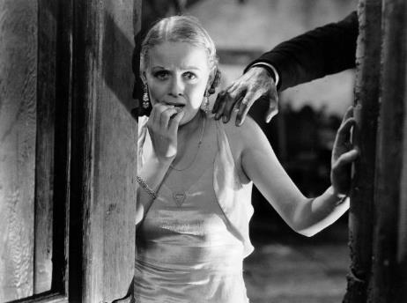
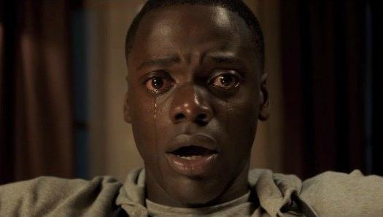
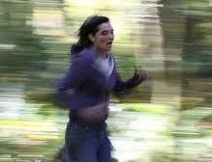
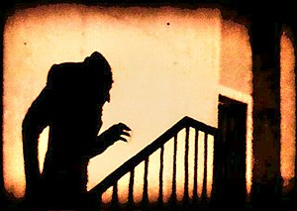
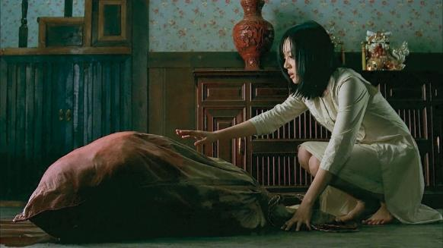
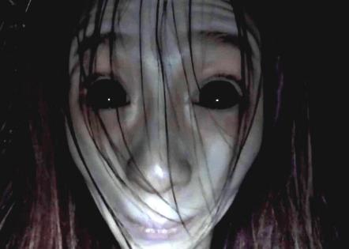
Task: create a mini horror film score
1 | Choose any three still images to create your storyboard
2 | Create a scary film score using the horror techniques
Notes:
Printable list of techniques on next slide

Slide 66
Techniques | Techniques | Techniques
Ostinato (Repeated patterns) | Ostinato (Repeated patterns) | Ostinato (Repeated patterns)
Pitch bends (glissando) | Pitch bends (glissando) | Pitch bends (glissando)
Long durations (Held notes) | Long durations (Held notes) | Long durations (Held notes)
Accelerando (Gradually getting faster) | Accelerando (Gradually getting faster) | Accelerando (Gradually getting faster)
Crescendo (Gradually getting louder) | Crescendo (Gradually getting louder) | Crescendo (Gradually getting louder)
Dynamics extremes (Silence >>> suddenly loud) | Dynamics extremes (Silence >>> suddenly loud) | Dynamics extremes (Silence >>> suddenly loud)
Pitch extremes (Very high + very low). | Pitch extremes (Very high + very low). | Pitch extremes (Very high + very low).
Note clashes (A cluster of 3 or 4 notes right next to each other) | Note clashes (A cluster of 3 or 4 notes right next to each other) | Note clashes (A cluster of 3 or 4 notes right next to each other)
Timbre clichés (high piano, spooky synths, theremin, whispers, chanting, noises) | Timbre clichés (high piano, spooky synths, theremin, whispers, chanting, noises) | Timbre clichés (high piano, spooky synths, theremin, whispers, chanting, noises)
Notes:
Printable sheet

Slide 67
Connect: Try out these themes on piano
Can you identify the movies?
WonderWoman Star Wars Lord of the Rings
E G B
Bb G
Bb G
Bb G
F# F# F# D F#
F# D A F#
C# C# C# D A
F D A F#
A__ G__
G G A___
D E F __
E D C__
D E D__
C B

Slide 68
What is a leitmotif and how are they used in film scores?
I can explain what a leitmotif is I can play a leitmotif I can explain why and how a leitmotif might develop during a film I can compose / develop a leitmotif for a character

Slide 69
What is a leitmotif and how are they used in film scores?
Keywords
Motif – a short musical fragment Leitmotif – a musical motif associated with a character or emotion Develop – to change a motif using the elements of music e.g. making it slower

Slide 70
Activate: Tools of the trade: leitmotif
Characters, places or objects often have their own musical theme within the film score, called a leitmotif.
The themes you just played are all leitmotifs
E G B
Bb G
Bb G
Bb G
F# F# F# D F#
F# D A F#
C# C# C# D A
F D A F#
A__ G__
G G A___
D E F __
E D C__
D E D__
C B
Wonderwoman Darth Vader
The Fellowship of the Ring

Slide 71
Activate: Tools of the trade: leitmotif
Film Composers John Williams and Howard Shore use lots of leitmotifs
Watch this video PL28 about themes/ leitmotifs in the Howard Shore’s Lord of The Rings film score
Watch this video on how John Williams built a leitmotif for the character of Yoda PL29
Notes:
PL27 Watch 0:00-5:30 only
PL28 Watch 0:00-2:10 only

Slide 72

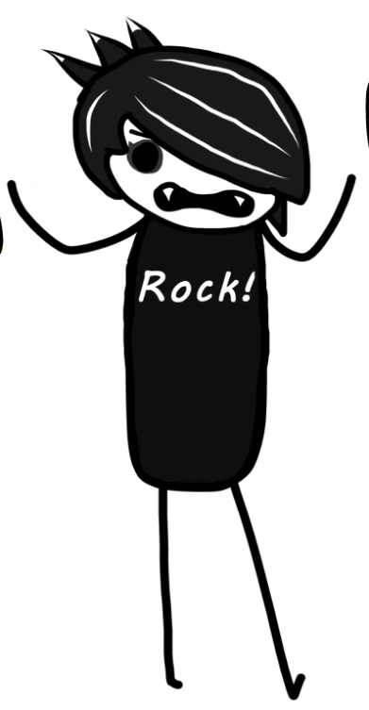
Co-composing
What scales and leitmotifs would suit these characters?
Scale
All black notes from F#
C Eb F F# G Bb C
All white notes from A-A
Any 6 notes

Slide 73
Paired or independent task: create a leitmotif for a character
1 | Choose a character
2 | Pick a scale to give your motif more identity
3 | Create a short motif which fits that character.
4 | Choose a suitable timbre
5 | Extension: change your motif as your character develops.

Slide 74
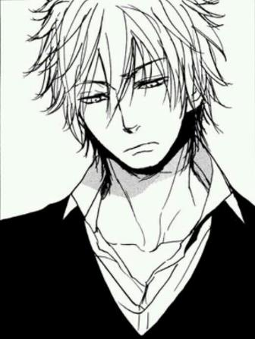
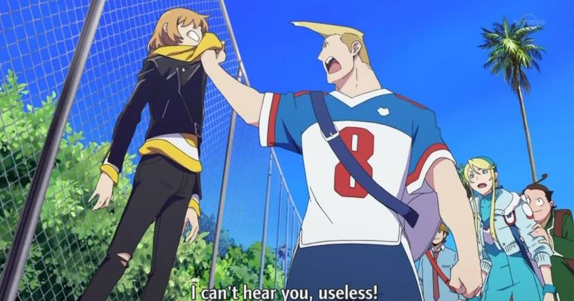

Choose a character
 | Notes | What scale is that?
1 | All black notes from F# | F# Major pentatonic
2 | C Eb F F# G Bb C | C Blues scale
3 | All white notes from A-A | A natural minor
4 | Any 6 notes | Chromatic scale

Slide 75

Developing a leitmotif to fit the story
Leitmotifs can be developed through the film as the character or situation develops.
This helps to tell the story without words.
Watch Wonderwoman's changing leitmotif PL30

Slide 76
Ways you can develop a leitmotif
Change the speed
Change the rhythm
Change the timbre
Change the harmony / accompaniment
Combine it with another leitmotif
Change the notes slightly e.g. just one

Slide 77
Try this: Fellowship of the Ring Leitmotif
A____G____G G A______
D E F ____EDC_____
DED____
CB (repeat)
Next, develop the leitmotif
Speed
Rhythm
Timbre
Harmony / accompaniment
Combine with another leitmotif
Change the notes slightly e.g. just one
Notes:
See next slide for musical notation versions

Slide 78
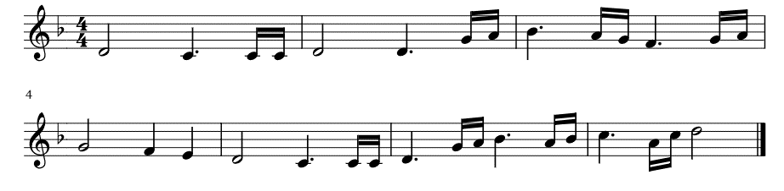
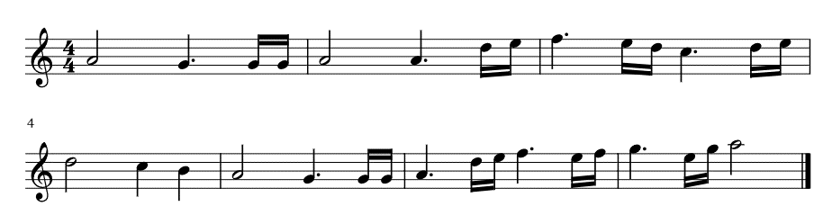
Fellowship Theme D minor
Fellowship Theme A minor

Slide 79
Quiz
Can you name a film composer?
Can you remember what diegetic music is? (from previous lessons)
Can you name another job role in film music/sound? (from previous lessons)
What is a leitmotif?
What instrument was used to play Wonderwoman’s leitmotif ?
What other famous leitmotifs have you heard today?
What happens to a character’s leitmotif through a film?
Describe one technique you could use to develop a leitmotif

Slide 80
Teacher instructions for connect task
Open the At the Movies YouTube playlist in two separate tabs in your web browser
Set PL31 Space hopper race ready on pause, but mute its audio.
Set PL32 Mussorgsky playing on the other tab from exactly 11m:39s. (Warning! Cannons are loud!)
Put the muted PL 31 Space hopper race tab on screen so students can watch it with its new film score
Repeat using PL33 Tchaikovsky and PL34 Offenbach as the sound track to the space hopper race and let students comment on the effect each time
  what different things do they notice in the space hopper race each time because of the music?

Slide 81
Connect: Film scores – does an amusing film really need a comedy film score? Isn’t it just funny anyway?
Watch this space hopper race with three different film scores…

Slide 82
What musical techniques are used in the comedy film underscores?
Recognise and name different comedy film music techniques Recreate techniques on keyboards

Slide 83
What musical tricks of the trade are used in the comedy film genre?
Prior learning | New keywords
Tempo Pitch Timbre Mickey mousing | Trills and tremolandos Pizzicato Glissando

Slide 84
What is a comedy film underscore for?
We know that the underscore tells the audience what to feel and what to expect, not what is on screen.
A number of musical techniques have developed from classical, musical hall, and pantomime music which we now automatically think of as “funny”

Slide 85
Comedy film underscore techniques
Can you demonstrate any?
Mickey mousing
Bouncy rhythms (oompah accompaniment)
Timbre clichés: bass clarinet, pizzicato strings, slide whistle, low brass, low strings, xylophones, piccolo, muted trumpets, triangle
Trills and tremolos (wobbly notes)
Fast tempo
Glissando (sliding notes)
Pitch extremes (very high + very low)
Ascending and descending scales

Slide 86
Tools of the trade: timbre clichés
Some instruments have been overused for comedy and as soon as we heard them we think “funny”
PL35 Home Alone2 The Thieves : bass clarinet, low brass, contrabassoon+ piccolo, pizzicato strings, xylophone, triangle, low strings
Notes:
PL35: Start from 0:00-1:45

Slide 87
Tools of the trade:
Bouncy rhythms
Trills and tremolos
Oompah accompaniments can be humorous, silly or cute
Trills can mimic laughter
Tremolos build comedy tension
Listen to PL35 Home Alone2 The Thieves again.
  At 0:05-0:25 you will hear an oompah accompaniment
  At 0:40 you will hear lots of tremolos
Notes:
PL35: Start from 0:00-1:00

Slide 88
Tools of the trade: fast tempo
Anything music is funnier when it’s speeded up.
Fast tempos are often used for chase scenes
PL36 Home Alone: Man of the House: here the tempo changes between very fast and slow
Notes:
PL36: Start from 0:0;0:45
05: Man of the House – very fast tempo, with tremolo strings, prominent brass and percussion, with gaps for slower pizzicato bass strings
At 1m30 we also hear a low pitched leitmotif that is heard in the 1st movie

Slide 89
Tools of the trade: glissando
Glissando is the musical term for a note that slides up or down in pitch
This has a great comic effect. The classic use is when someone slips on a banana skin
If your keyboard has a pitch bend control, you can use this to try a glissando
Notes:
PL35: Start from 0:00-1:00

Slide 90
Comedy film music techniques PL37-43
Techniques | Home Alone OST6 Scammed | Home Alone OST10 Plane | Home Alone OST16 Attack | HomeAlon2 OST14 Race | HomeAlon2 OST20 Running | HomeAlon2 OST22 Kevin’s trap | HomeAlon2 OST23 Down
Mickey mousing
Bouncy rhythms (oompah)
Timbre clichés: bass clarinet, pizzicato strings, slide whistle, low brass, low strings, xylophones, piccolo, muted trumpets, triangle
Trills and tremolos (wobbly notes)
Fast tempo
Glissando (sliding notes)
Pitch extremes (Very high + very low)
Ascending and descending scales
Listen to some of these clips
When you recognise a comedy technique, tick the box.
Notes:
I’ve included several options for this task as sometimes tracks are deleted from YouTube because of copyright issues
Home Alone 1
0ST6 Scammed by a kindergartner: Someone is up to no good, cheeky clarinets, triangles, low brass, oom-pah
OST10 Making the plane: Fast tempo, oompah, low strings action music with a hint of Christmas as the family rush to the airport.
OST16 The Attack on the house: bass clarinet, descending scale, pizzicato, silences, ascending chromatic scales, sustained notes, tremolo, oompah
Home Alone 2
OST14 Race
OST20 Running
OST22 Kevin’s Booby Trap
OST23 Down the Rope

Slide 91
Task options:
Watch how a comedy sound track is created here PL44
Have a go at adding comedy music to one or more of these clips– start at 0:25 maybe? PL45

Slide 92
How can we create the shortest, scariest or funniest movie of all time?
Work effectively in a team
Plan and film a 30 second silent horror or comedy movie
Create suitable music to help tell the story which demonstrates the use of at least three underscore composition techniques

Slide 93
Horror underscore techniques:
Can you spot any in this clip? PL46
Mickey mousing
Ostinato (repeated patterns)
Timbre clichés (high piano, spooky synths, Theremin, whispers, chanting, noises)
Long durations (held notes)
Accelerando (gradually getting faster)
Dynamics extremes (silence>> suddenly loud)
Pitch extremes (high & low)
Note clashes (3 or 4 close together pitches)
Crescendo (gradually getting louder)
Glissando (pitch bends)

Slide 94
Comedy film underscore techniques
Can you spot any in this clip? PL47
Mickey mousing
Bouncy rhythms (oompah accompaniment)
Timbre clichés: bass clarinet, pizzicato strings, slide whistle, low brass, low strings, xylophones, piccolo, muted trumpets, triangle
Trills and tremolos (wobbly notes)
Fast tempo
Glissando (sliding notes)
Pitch extremes (very high + very low)
Ascending and descending scales

Slide 95
Week 1
1 | Get into groups of 3-4
2 | Plan your 6 scenes
3 | Sketch each scene in the box
4 | You don’t need dialogue
5 | Write intertitles above each sketch to help the audience understand the action. We will create these on Powerpoint and filmthe screen to insert them into the movie
Rules
You must show me a completed storyboard with your silent movie intertitles before you start rehearsing.
Notes:
They appreciated this level of independence and greatly enjoyed creating their movies,
They then edited their movies using iMovie for iPhone to edit and recorded classroom instruments using the iMovie voiceover function to add a ‘film score’.
This could be extended with an additional ‘foley track’ if time allows

Slide 96

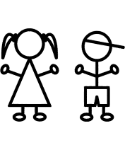
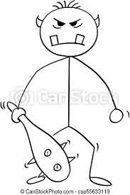
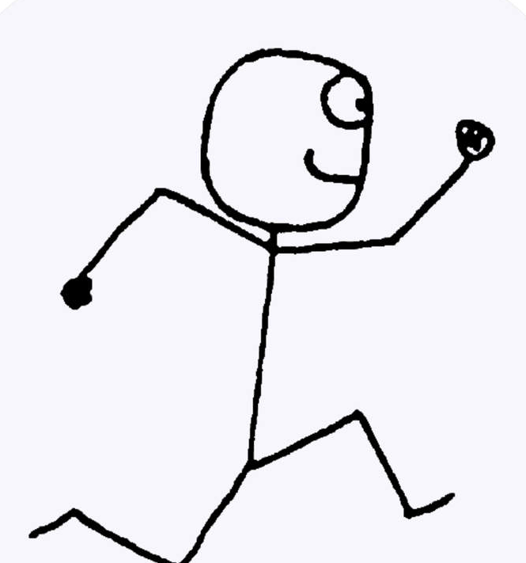

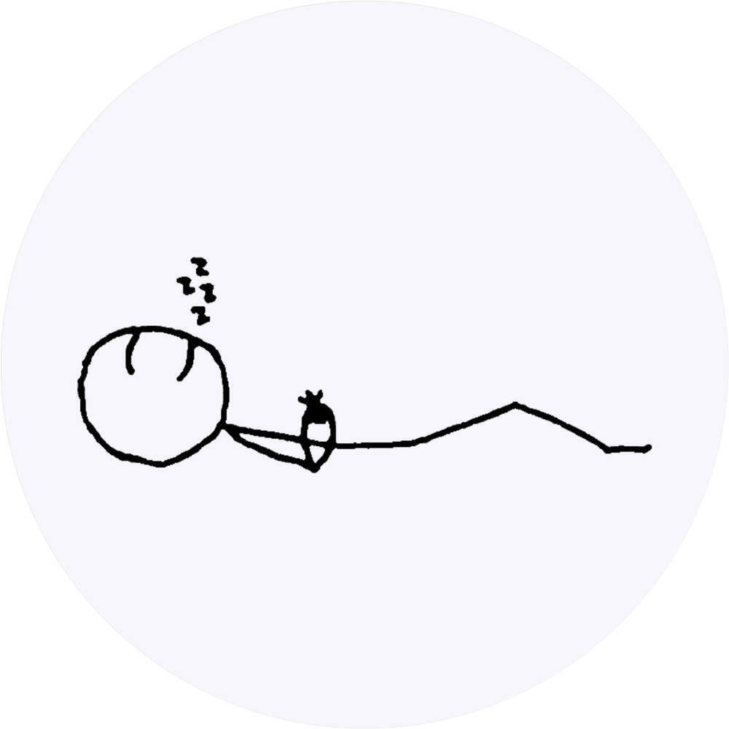

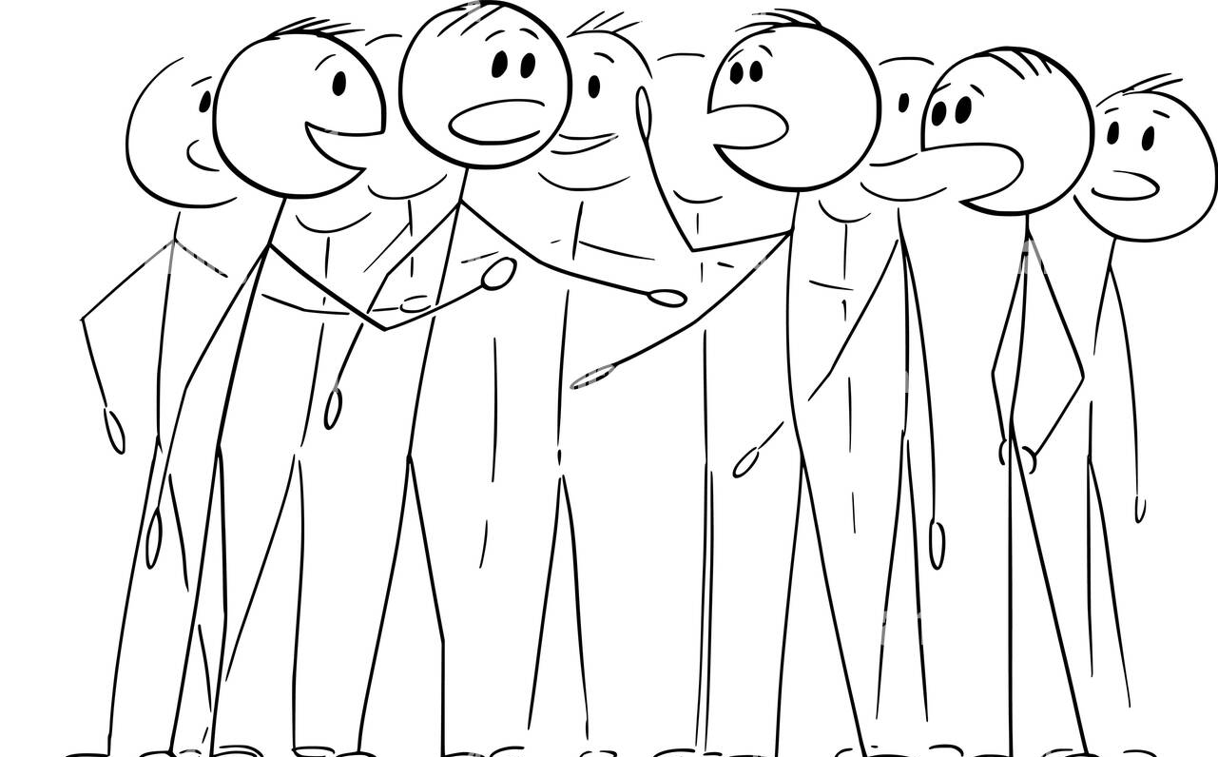
Examples of completed story board
“The villain stalks the basement!”
“Meanwhile…students study, blissfully unaware of the threat to their lives”
She creeps up the stairs…
Alison stalking in corridor, looking menacing, Paul looking scared and runs off
Pete, Sarah and Megan writing in books, looking peaceful
Alison creeps up the stairs
“what’s that noise?”
“where’s Josh?
“Too late!”
Students stop and listen / look up/ cup their ears
Looking round, panicking, running around
Josh is on the floor, presumably attacked by the monster

Slide 97
Notes:
Storyboard with fewer scenes / more space

Slide 98
 | L | I | T | H | E
1 | Paul , Roary, | Jack, Ryan, Charlie, Alex | Lydia, Katy S Jess, Max | Favour, Jess,Elisha, Daisy
2 |  | JackC, Dylan, Cory, Joss | Ellie U Sasha Katy-Lee | Madison Ethan Ewan Daniel Immie
3 |  | Connor, Alfie, Liam, James | HarryS, Serenity Caitlin | Michael, Will, Mark, Curtis
4 |  | George, Ciara, Crystal, EllieT | Darcey, Melodie, Ma Mary-Ann | SamAdam James Kyle
5 |  | Hadi, Erno, Lewis | Tracy Millie | Amelia Caitlin, Leonie, Leah
6 |  | Annie, Ella | Leo, Kelsey, Sam,Dylan
7 |  | Ellie, Faye | Toby, Daniel, Jamie E, Jamie D, Lucas
8 |  | Olivia J, Zak,Ellie W

Slide 99
Week 2
1 | Film your movie on an iPhone /Android
2 | Film your intertitles (put them into Powerpoint and film the screen) and add them to the correct points in your movie
3 | Edit your movie using iMovie
4 | Apply a black and white or silent movie filter if you didn’t film in black and white
You may use the following areas only:
Do not disturb other classes. Be creative!
Notes:
They appreciated this level of independence and greatly enjoyed creating their movies,
They then edited their movies using iMovie for iPhone to edit and recorded classroom instruments using the iMovie voiceover function to add a ‘film score’.
This could be extended with an additional ‘foley track’ if time allows

Slide 100
It was me all along.

Slide 101
“Horror
intertitle
template!”

Slide 102
“Horror
intertitle
template!”

Slide 103
“Horror
intertitle
template!”

Slide 104
“Comedy
intertitle
template!”

Slide 105
“Comedy
intertitle
template!”

Slide 106
Week 3
1 | Experiment and create the film underscore to go with your scenes
2 | Remember to use at least three techniques from your chosen genre. Bonus points for creating a leitmotif for a character
3 | Record the film music into your edited movie using the voiceover function on iMovie for iPhone
Notes:
They appreciated this level of independence and greatly enjoyed creating their movies,
They then edited their movies using iMovie for iPhone to edit and recorded classroom instruments using the iMovie voiceover function to add a ‘film score’.
This could be extended with an additional ‘foley track’ if time allows

Slide 107
Horror film music techniques
Techniques | Jaws | Halloween | Alien | Terror | The Thing | Nightmare on Elm St
Ostinato (Repeated patterns)
Timbre clichés (high piano, spooky synths, Theremin, whispers, chanting, noises)
Long durations (Held notes)
Accelerando (Gradually getting faster)
Dynamics extremes (Silence >>> suddenly loud)
Pitch extremes (Very high + very low)
Note clashes (A cluster of 3 or 4 notes right next to each other)
Crescendo (Gradually getting louder)
Pitch bends (glissando)

Slide 108
Comedy film music techniques
Techniques | Home Alone OST6 Scammed | Home Alone OST10 Plane | Home Alone OST16 Attack | HomeAlon2 OST14 Race | HomeAlon2 OST20 Running | HomeAlon2 OST22 Kevin’s trap | HomeAlon2 OST23 Down
Bouncy rhythms (oompah accompaniment)
Timbre clichés: bass clarinet, pizzicato strings, slide whistle, low brass, low strings, xylophones, piccolo, muted trumpets, triangle
Trills and tremolos (wobbly notes)
Fast tempo
Glissando (sliding notes)
Pitch extremes (Very high + very low)
Ascending and descending scales
Notes:
I’ve included several options for this task as sometimes tracks are deleted from YouTube because of copyright issues
Home Alone 1
0ST6 Scammed by a kindergartner: Someone is up to no good, cheeky clarinets, triangles, low brass, oom-pah
OST10 Making the plane: Fast tempo, oompah, low strings action music with a hint of Christmas as the family rush to the airport.
OST16 The Attack on the house: bass clarinet, descending scale, pizzicato, silences, ascending chromatic scales, sustained notes, tremolo, oompah
Home Alone 2
OST14 Race
OST20 Running
OST22 Kevin’s Booby Trap
OST23 Down the Rope

Slide 109
Liverpool Film Festival | http://www.liviff.com/
Museum of Liverpool | The first national museum devoted to the history of a regional city, it showcases popular culture while tackling social, historical and contemporary issues.
FACT | https://www.fact.co.uk/ FACT is the UK's leading organisation for the support and exhibition of art and film that embraces new technology and explores digital culture. We believe in enriching lives and shaping the future through film, art and creative technology
Further watching | https://www.connollymusic.com/stringovation/whats-it-like-to-be-part-of-an-orchestra-recording-a-film-score
Further reading | https://musiciansunion.org.uk/legal-money/job-contracts-and-business-agreements/specimen-sync-licences

Slide 110
Liverpool Film Office, Cunard Building | https://www.liverpoolfilmoffice.tv/ https://www.liverpoolfilmoffice.tv/made-in-liverpool/ See which productions have been made in Liverpool, over the years https://www.liverpoolfilmoffice.tv/made-in-liverpool/city-of-producers/ Why do producers choose Liverpool ?
Filming in Sefton | https://www.sefton.gov.uk/around-sefton/filming-media-production-in-sefton Productions filmed in Sefton: Alfie - starring Jude Law, Peaky Blinders - starring Cillian Murphy, Good Cop - starring Warren Brown, Das Boot War Of The Worlds, Hollyoaks, Subway Advertisement Moving On, Location, Location, Location, Coast Inside Out, Cbeebies, Springwatch, The Five, Countryfile The One Show, Panorama, Native, Nickelodeon, Ordinary Lies
Filming in Halton | https://hbcnewsroom.co.uk/netflix-filming-in-halton-this-weekend/
Filming at Knowsley Hall | https://knowsleyhallvenue.co.uk/filming/ Filming on the Knowsley Estate

Slide 111
Week 2 task : Dialogue recording
Scene from: The Social Network, 2010
MARK * I apologize, okay? Sit down. I'm sorry and I mean it.
ERICA I have to study.
MARK You don't have to study. Let's just talk.
ERICA I can't.
MARK Why?
ERICA Because it's exhausting. Going out with you is like dating a StairMaster.
MARK All I meant is that you go to B.U. ** and so you're not likely to--I wasn't making a comment on your parents—I was saying you go to B.U.
ERICA I have to go study.
MARK You don't have to study.
ERICA How do you know I don't have to study?!
MARK Because you go to B.U.!
ERICA stares at him...
MARK (CONT'D) (BEAT) Do you want to get some food?
ERICA I'm sorry you're not sufficiently impressed with my education.
MARK And I'm sorry I don't have a rowboat.
ERICA I think we should just be friends.
MARK I don't need friends.
ERICA I was being polite, I had no intention of being friends with you.
MARK You're really leaving. [ ERICA takes MARK's hand and looks at him tenderly.]
ERICA Listen, You're going to be successful and rich. But you're going to go through life thinking that girls don't like you because you're a tech geek. And I want you to know, from the bottom of my heart, that that won't be true. It'll be because you're an asshole.
* Mark is Mark Zuckerberg, CEO of Facebook Erica is his girlfriend
** BU is Boston University

Slide 112
Horror film music techniques
Techniques | Jaws | Halloween | Alien | Terror | The Thing | Nightmare on Elm St
Mickey Mousing
Ostinato (Repeated patterns)
Timbre clichés (high piano, spooky synths, Theremin, whispers, chanting, noises)
Long durations (Held notes)
Accelerando (Gradually getting faster)
Dynamics extremes (Silence >>> suddenly loud)
Pitch extremes (Very high + very low)
Note clashes (A cluster of 3 or 4 notes right next to each other)
Crescendo (Gradually getting louder)
Glissando (pitch bends)

Slide 113
Comedy film music techniques
Techniques | Home Alone OST6 Scammed | Home Alone OST10 Plane | Home Alone OST16 Attack | HomeAlon2 OST14 Race | HomeAlon2 OST20 Running | HomeAlon2 OST22 Kevin’s trap | HomeAlon2 OST23 Down
Mickey mousing
Bouncy rhythms (oompah)
Timbre clichés: bass clarinet, pizzicato strings, slide whistle, low brass, low strings, xylophones, piccolo, muted trumpets, triangle
Trills and tremolos (wobbly notes)
Fast tempo
Glissando (sliding notes)
Pitch extremes (Very high + very low)
Ascending and descending scales
Notes:
I’ve included several options for this task as sometimes tracks are deleted from YouTube because of copyright issues
Home Alone 1
0ST6 Scammed by a kindergartner: Someone is up to no good, cheeky clarinets, triangles, low brass, oom-pah
OST10 Making the plane: Fast tempo, oompah, low strings action music with a hint of Christmas as the family rush to the airport.
OST16 The Attack on the house: bass clarinet, descending scale, pizzicato, silences, ascending chromatic scales, sustained notes, tremolo, oompah
Home Alone 2
OST14 Race
OST20 Running
OST22 Kevin’s Booby Trap
OST23 Down the Rope

Slide 115
Notes:
Storyboard with fewer scenes / more space

Slide 116
Notes:
Storyboard with fewer scenes / more space

Slide 117
____________’s Leitmotif
Notes and ideas to help you remember your leitmotif
Character sketch (label)
____________’s character traits
How are you reflecting the traits of ____________ through your performing?
Notes:
Notes:
Optional , if a worksheet is required for evidence

Slide 118
SELF ASSESSMENT GRID : “Silent Movie” 1 Adam Kyle James Sam
 | S H L
Composing Not finished | □ Compose music for a silent movie which uses Apple loops | □ Compose music for a silent movie which uses 1-2 horror techniques | □ Compose music for a silent movie which uses 3-5 horror techniques | □ Compose music for a silent movie which uses 5-7 horror techniques creatively | □ Compose music for a silent movie which uses 8-9 horror techniques
Independence and resilience | □ Support needed to make progress Does not use resources sensibly | □ Some independent work. | □ Works independently using resources with occasional assistance | □ Works independently and quickly using resources provided sensibly | □ Leads the group in rehearsal or performance
Techniques
Ostinato (Repeated patterns) | Accelerando (Gradually getting faster)
Timbre clichés (high piano, spooky synths, Theremin, whispers, chanting, noises) | Dynamics extremes (Silence >>> suddenly loud)
Long durations (Held notes) | Pitch extremes (Very high + very low)
Note clashes (A cluster of 3 or 4 notes right next to each other) | Crescendo (Gradually getting louder)
Pitch bends (glissando)
p1

Slide 119
SELF ASSESSMENT GRID : “Silent Movie” 2 Tom Caitlin Leonie Amelia Layla
 | S H L
Composing Exported Emailed | □ Compose music for a silent movie which uses Apple loops | □ Compose music for a silent movie which uses 1-3 horror techniques | □ Compose music for a silent movie which uses 4-6 horror techniques | □ Compose music for a silent movie which uses 7-9 horror techniques creatively
Independence and resilience | □ Support needed to make progress Does not use resources sensibly | □ Some independent work. | □ Works independently using resources with occasional assistance | □ Works independently and quickly using resources provided sensibly
Techniques
Ostinato (Repeated patterns) | Accelerando (Gradually getting faster)
Timbre clichés (high piano, spooky synths, Theremin, whispers, chanting, noises) | Dynamics extremes (Silence >>> suddenly loud)
Long durations (Held notes) | Pitch extremes (Very high + very low)
Note clashes (A cluster of 3 or 4 notes right next to each other) | Crescendo (Gradually getting louder)
Pitch bends (glissando)
p1

Slide 120
SELF ASSESSMENT GRID : “Silent Movie” 3 Ewan Immie Daniel Madison Ethan
 | S H L
Composing Airdropped | □ Compose music for a silent movie which uses Apple loops | □ Compose music for a silent movie which uses 1-3 horror techniques | □ Compose music for a silent movie which uses 4-6 horror techniques | □ Compose music for a silent movie which uses 7-9 horror techniques creatively
Independence and resilience | □ Support needed to make progress Does not use resources sensibly | □ Some independent work. | □ Works independently using resources with occasional assistance | □ Works independently and quickly using resources provided sensibly
Techniques
Ostinato (Repeated patterns) | Accelerando (Gradually getting faster)
Timbre clichés (high piano, spooky synths, Theremin, whispers, chanting, noises) | Dynamics extremes (Silence >>> suddenly loud)
Long durations (Held notes) | Pitch extremes (Very high + very low)
Note clashes (A cluster of 3 or 4 notes right next to each other) | Crescendo (Gradually getting louder)
Pitch bends (glissando)
p1

Slide 121
SELF ASSESSMENT GRID : “Silent Movie” 4 Daisy Favour Pearl Jess Elisha
 | S H L
Composing Exported Emailed | □ Compose music for a silent movie which uses Apple loops | □ Compose music for a silent movie which uses 1-3 horror techniques | □ Compose music for a silent movie which uses 4-6 horror techniques | □ Compose music for a silent movie which uses 7-9 horror techniques creatively
Independence and resilience | □ Support needed to make progress Does not use resources sensibly | □ Some independent work. | □ Works independently using resources with occasional assistance | □ Works independently and quickly using resources provided sensibly
Techniques
Ostinato (Repeated patterns) | Accelerando (Gradually getting faster)
Timbre clichés (high piano, spooky synths, Theremin, whispers, chanting, noises) | Dynamics extremes (Silence >>> suddenly loud)
Long durations (Held notes) | Pitch extremes (Very high + very low)
Note clashes (A cluster of 3 or 4 notes right next to each other) | Crescendo (Gradually getting louder)
Pitch bends (glissando)
p1

Slide 122
SELF ASSESSMENT GRID : “Silent Movie” 5 Curtis Will Logan
 | S H L
Composing ?? | □ Compose music for a silent movie which uses Apple loops | □ Compose music for a silent movie which uses 1-3 horror techniques | □ Compose music for a silent movie which uses 4-6 horror techniques | □ Compose music for a silent movie which uses 7-9 horror techniques creatively
Independence and resilience | □ Support needed to make progress Does not use resources sensibly | □ Some independent work. | □ Works independently using resources with occasional assistance | □ Works independently and quickly using resources provided sensibly
Techniques
Ostinato (Repeated patterns) | Accelerando (Gradually getting faster)
Timbre clichés (high piano, spooky synths, Theremin, whispers, chanting, noises) | Dynamics extremes (Silence >>> suddenly loud)
Long durations (Held notes) | Pitch extremes (Very high + very low)
Note clashes (A cluster of 3 or 4 notes right next to each other) | Crescendo (Gradually getting louder)
Pitch bends (glissando)
p1

Slide 123
SELF ASSESSMENT GRID : “Silent Movie” 1 Adam Kyle James Sam
 | S H L
Composing | □ Compose music for a silent movie which uses Apple loops | □ Compose music for a silent movie which uses 1-2 horror techniques | □ Compose music for a silent movie which uses 3-5 horror techniques | □ Compose music for a silent movie which uses 5-7 horror techniques creatively | □ Compose music for a silent movie which uses 8-9 horror techniques
Independence and resilience | □ Support needed to make progress Does not use resources sensibly | □ Some independent work. | □ Works independently using resources with occasional assistance | □ Works independently and quickly using resources provided sensibly | □ Leads the group in rehearsal or performance
Techniques
Ostinato (Repeated patterns) | Accelerando (Gradually getting faster)
Timbre clichés (high piano, spooky synths, Theremin, whispers, chanting, noises) | Dynamics extremes (Silence >>> suddenly loud)
Long durations (Held notes) | Pitch extremes (Very high + very low)
Note clashes (A cluster of 3 or 4 notes right next to each other) | Crescendo (Gradually getting louder)
Pitch bends (glissando)
p1

